Slide 1
Pervasive Computing (Ubiquitous Computing)
MIS

Slide 2
Introduction to Pervasive Computing
Pervasive Computing is also called as Ubiquitous computing, and it is the new trend toward embedding everyday objects with microprocessors so that they can communicate information.
Pervasive computing is a combination of three technologies, namely:
Micro electronic technology: This technology gives small powerful device and display with low energy consumption.
Digital communication technology: This technology provides higher bandwidth, higher data transfer rate at lower costs and with world wide roaming.
The Internet standardization: This standardization is done through various standardization bodies and industry to give the framework for combining all components into an interoperable system with security, service and billing systems.

Slide 3
Pervasive Computing Environment
An environment where wireless communication, consumer electronics and computer technology were all merged into one.
It accesses information and render modern administration
Pervasive computing is the next dimension of personal computing
Pervasive computing will provide us with small portable personal assistant devices having high speed, wireless communication, lower power consumption rate, data storage in persistent memory, coin sized disk device, small colour display video and speech processing technology.

Slide 4
Key Characteristics of Pervasive computing:
Many devices can be integrated into one system for multi-purpose uses.
A huge number of various interfaces can be used to build an optimized user interface.
Concurrent operation of online and offline supported.
A large number of specialized computers are integrated through local buses and Internet.
Security elements are added to prevent misuse and unauthorized access.
Personalization of functions adapts the systems to the user’s preferences, so that no PC knowledge is required of the user to use and manage the system.

Slide 5
Applications
There are a rising number of pervasive devices available in the market nowadays. The areas of application of these devices include:
Retail
Airlines booking and check-in
Sales force automation
Healthcare
Tracking
Car information System
Email access via WAP (Wireless Application Protocol) and voice.

Slide 6
How ubiquitous computing is used
Pervasive computing applications have been designed for consumer use and to help people do their jobs.
An environment in which devices, present everywhere, are capable of some form of computing can be considered a ubiquitous computing environment. Industries spending money on research and development (R&D) for ubiquitous computing include the following:
energy
entertainment
healthcare
logistics
military

Slide 7
Importance
Because pervasive computing systems are capable of collecting, processing and communicating data, they can adapt to the data's context and activity.
That means, in essence, a network that can understand its surroundings and improve the human experience and quality of life.

Slide 8
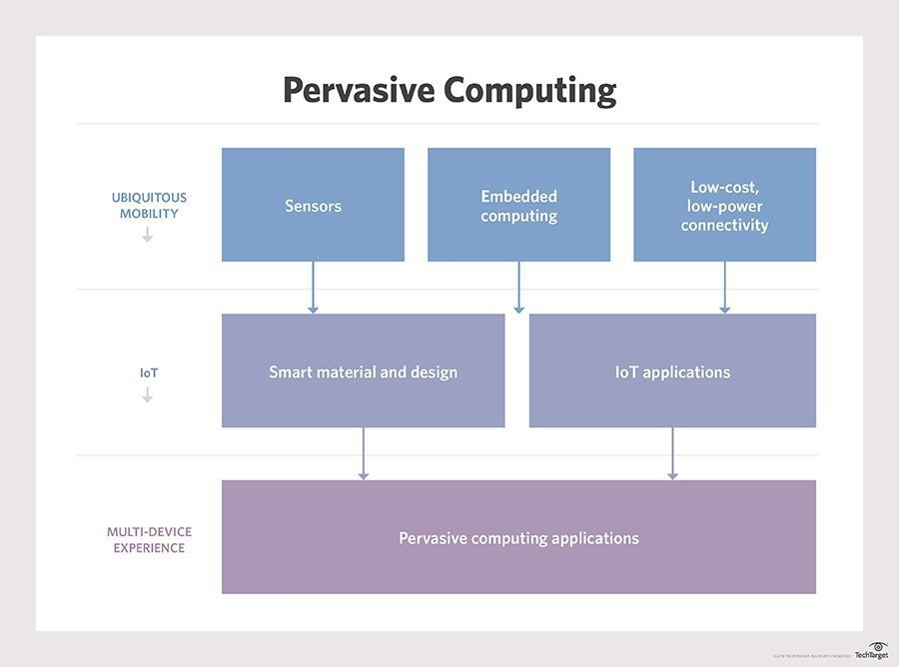

Slide 9
Advantages of Pervasive Computing
pervasive computing requires less human interaction than any other computing environment where there may be more connected devices, but that the extraction and processing of data requires more intervention.
Because pervasive computing systems are capable of collecting, processing and communicating data, they can adapt to the data's context and activity.
That means, in essence, that a network that can understand its surroundings and improve the human experience and quality of life.

Slide 10
Examples
Examples of pervasive computing include
electronic toll systems on highways;
tracking applications, such as Life360, which can track the location of the user, the speed at which they are driving and how much battery life their smartphone has;
Apple Watch;
Amazon Echo;
smart traffic lights; and
Fitbit.

Slide 11
Cloud Computing
MIS

Slide 12
What is cloud computing
Cloud computing is the delivery of on-demand computing services -- from applications to storage and processing power -- typically over the internet and on a pay-as-you-go basis.
Cloud Computing as a type of computing that delivers convenient, on-demand, pay-as-you-go access for multiple customers to a shared pool of configurable computing resources (e.g., servers, networks, storage, applications, and services) that can be rapidly and easily accessed over the Internet.
Cloud computing allows customers to acquire resources at any time and then delete them the instant they are no longer needed.

Slide 13
Evolution of Modern IT infrastructure
• Stand-alone mainframes:
• Mainframe and dumb terminals
• Stand-alone personal computers
• Local area networks (client/server computing):
• Enterprise computing
• Cloud computing and mobile computing

Slide 14
Cloud Computing Characteristics
why so many organizations are utilizing cloud computing?
Cloud Computing Provides On-Demand Self-Service: A customer can access needed computing resources automatically. This characteristic gives customers elasticity and flexibility.
Cloud Computing Encompasses the Characteristics of Grid Computing. Grid computing pools various hardware and software components to create a single IT environment with shared resources.
Cloud Computing Encompasses the Characteristics of Utility Computing.
Cloud Computing Utilizes Broad Network Access
Cloud Computing Pools Computing Resources.
Cloud Computing Often Occurs on Virtualized Servers.

Slide 15
Grid Computing
Grid computing shares the processing resources of many geographically dispersed computers across a network.
• Grid computing enables organizations to utilize their computing resources more efficiently.
• Grid computing provides fault tolerance and redundancy, meaning that there is no single point of failure, so the failure of one computer will not stop an application from executing.
• Grid computing makes it easy to scale up—that is, to access increased computing resources (i.e., add more servers)—to meet the processing demands of complex applications.
• Grid computing makes it easy to scale down (remove computers) if extensive processing is not needed.

Slide 16
Server Virtualization
Server virtualization uses software-based partitions to create multiple virtual servers— called virtual machines—on a single physical server.
The major benefit of this system is that each server no longer has to be dedicated to a particular task. Instead, multiple applications can run on a single physical server, with each application running within its own software environment.
Virtualization enables companies to increase server utilization
In addition, companies realize cost savings in two areas. First, they do not have to buy additional servers to meet peak demand. Second, they reduce their utility costs because they are using less energy.

Slide 18
Different Types of Clouds
Public Cloud: Public clouds are shared, easily accessible, multi-customer IT infrastructures that are available nonexclusively to any entity in the general public (individuals, groups, and/or organizations). Public cloud vendors provide applications, storage, and other computing resources as services over the Internet.
Private Cloud: Private clouds (also known as internal clouds or corporate clouds) are IT infrastructures that can be accessed only by a single entity or by an exclusive group of related entities that share the same purpose and requirements, such as all of the business units within a single organization. Private clouds provide IT activities and applications as a service over an intranet within an enterprise. Enterprises adopt private clouds to ensure system and data security.
Hybrid Cloud: Hybrid clouds are composed of public and private clouds that remain unique entities, but are nevertheless tightly integrated. This arrangement offers users the benefits of multiple deployment models. Hybrid clouds deliver services based on security requirements, the mission-critical nature of the applications, and other company-established policies.

Slide 19
Public clouds, private clouds, and hybrid clouds.

Slide 20
Vertical Clouds
Vertical Clouds: A vertical cloud is a set of cloud computing services optimized for use in a particular industry, or for a specific business model.
It is now possible to build cloud infrastructure and applications for different businesses—the construction, finance, or insurance businesses, for example—thus building vertical clouds (www.vertical-cloud.com).
Organizations with niche IT requirements can benefit greatly from a vertical cloud approach.

Slide 21
Cloud Computing Services
Cloud computing services are based on three models:
infrastructure-as-a-service (IaaS),
platform-as-a-service (PaaS), and
software-as-a-service (SaaS).
These models represent the three types of computing generally required by consumers: infrastructure to run software and store data (IaaS), platforms to develop applications (PaaS), and software applications to process their data (SaaS).
All three share certain characteristics. First, customers rent them instead of buying them. This arrangement shifts IT from a capital expense to an operating expense. Second, vendors are responsible for maintenance, administration, capacity planning, troubleshooting, and backups. Finally, obtaining additional computing resources— that is, scale from the cloud—is usually fast and easy.

Slide 22
Comparison of on-premise software, infrastructure-as-a-service, platform-as-a-service, and software-as-a-service.

Slide 23
Infrastructure-as-a-Service
Cloud computing providers offer remotely accessible servers, networks, and storage capacity
IaaS customers are often technology companies with IT expertise.
IaaS users install their operating system and their application software on the cloud computing provider’s computers
Cloud providers typically bill IaaS services on a utility computing basis—that is, the cost reflects the amount of resources the user consumes.
Amazon is a well-known IaaS provider. These services include its Simple Storage Service (S3) for storing their customers’ data and its Elastic Compute Cloud (EC2) service

Slide 24
Platform-as-a-Service
In the platform-as-a-service (PaaS) model, customers rent servers, operating systems, storage, a database, software development technologies such as Java and .NET, and network capacity over the Internet.
The PaaS model allows the customer both to run existing applications and to develop and test new applications.
PaaS offers customers several advantages:
No cost and complexity of buying and managing the underlying hardware and software.
Underlying computing and storage resources automatically scale to match application demand
Operating system features can be upgraded frequently.
Geographically distributed development
PaaS services can be provided by diverse sources located throughout the world.
Initial and ongoing costs can be reduced by the use of infrastructure services from a single vendor

Slide 25
Software-as-a-Service
With the software-as-a-service (SaaS) delivery model, cloud computing vendors provide software that is specific to their customers’ requirements.
SaaS providers typically charge their customers a monthly or yearly subscription fee.
The customers do not control either the software, beyond the usual configuration settings, or the infrastructure, beyond changing the resources they use, such as the amount of disk space required for their data.
What differentiates SaaS applications from other applications is their ability to scale.
To reduce the risk of an infrastructure outage, SaaS providers regularly back up all of their customers’ data.

Slide 26
Desktop-as-a-service (DaaS)
A subset of SaaS is the desktop-as-a-service (DaaS) model, also known as a cloud desktop or desktop in the cloud.
In this model, a SaaS provider hosts a software environment for a desktop personal computer, including productivity and collaboration software.
The DaaS model can be financially advantageous for consumers because they do need to purchase a fully configured personal computer, or fat client.
In addition, this model makes the PC environment simpler to deploy and administer.

Slide 27
The Benefits of Cloud Computing
Benefit 1: Cloud Computing Has a Positive Impact on Employees
Benefit 2: Cloud Computing Can Save Money
Benefit 3: Cloud Computing Can Improve Organizational Flexibility and Competitiveness

Slide 28
Concerns and Risks with Cloud Computing
Concern 1: Legacy IT Systems
Concern 2: Reliability
Concern 2: Reliability
Concern 4: Security
Concern 5: The Regulatory and Legal Environment
Concern 6: Criminal Use of Cloud Computing

Slide 29
Social Computing
MIS

Slide 30
CHAPTER OUTLINE

